Slide 1


Day – 25 : Assignment on Case Function
Course created by Satish Dhawale | www.skillcourse.in

Slide 2
Assignment : CASE with AND & OR Operators – Stock Status
We will classify products based on quantity available:
In Stock if quantity is 10 or more.
Limited Stock if quantity is between 5 and 9.
Out of Stock Soon if quantity is less than 5.

Slide 3
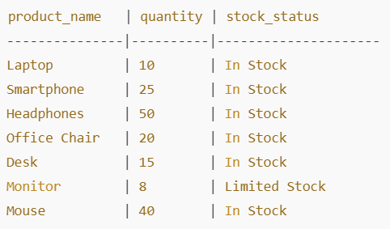
Output Should be like this

Slide 4
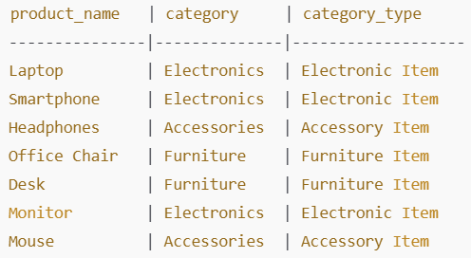
CASE with LIKE Operator – Category Classification
Check if the category name contains "Electronics Item" or "Furniture Item“ or “Accessory Item using LIKE
Output Should be like this

